Slide 1

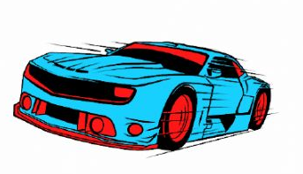
ADJECTIVES AND COMPARATIVE ADJECTIVES

Slide 2
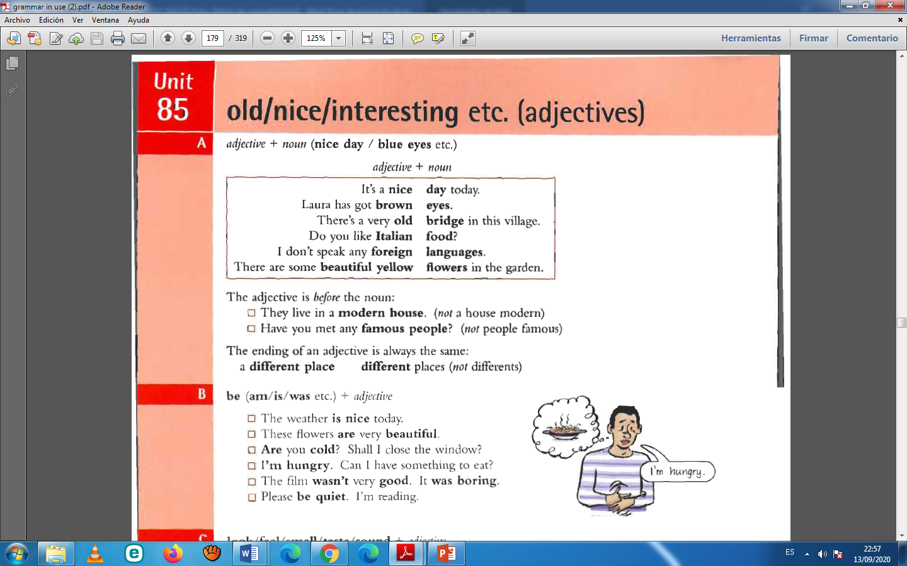

Slide 3
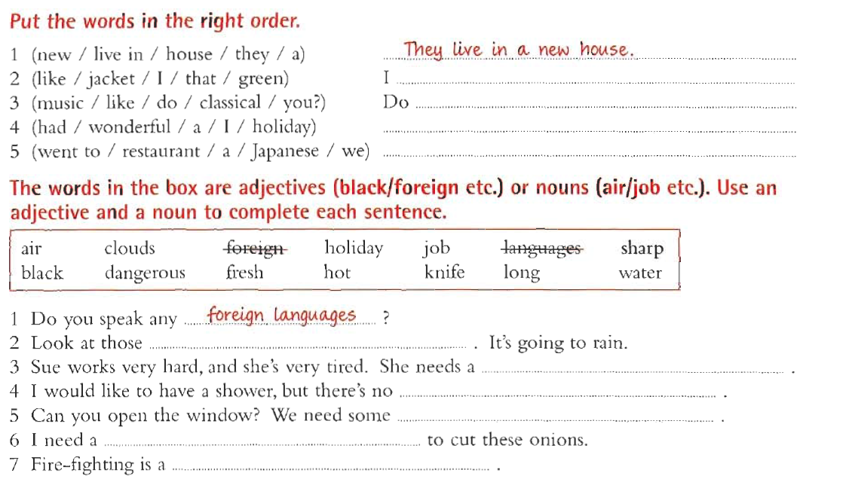
like that Green jacket.
you like classical music?
I had a wonderful holiday.
We went to a Japanese restaurant.
black clouds
long holiday
hot water
fresh air
sharp knife
dangerous job

Slide 4
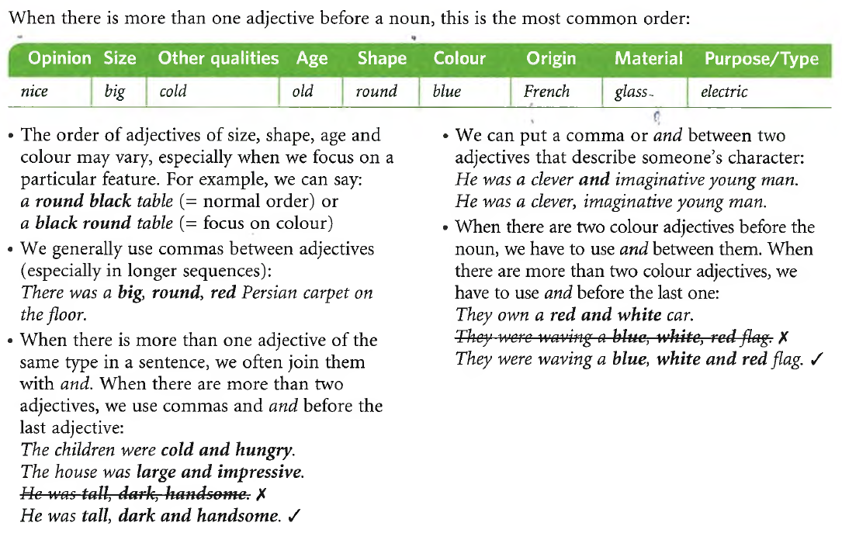

Slide 5
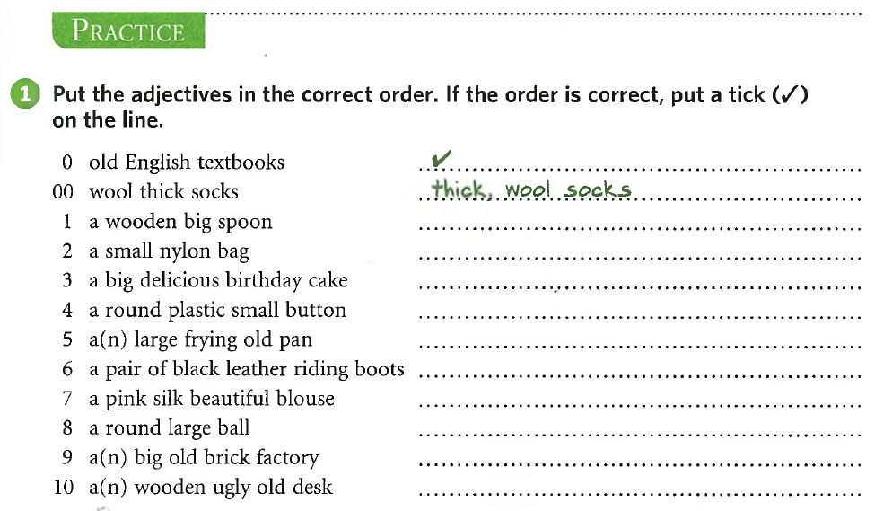

A big wooden spoon
A delicious big birthday cake
A small round plastic button
A large old frying pan
A beautiful pink silk blouse
A large round ball
An ugly old wooden desk

Slide 6
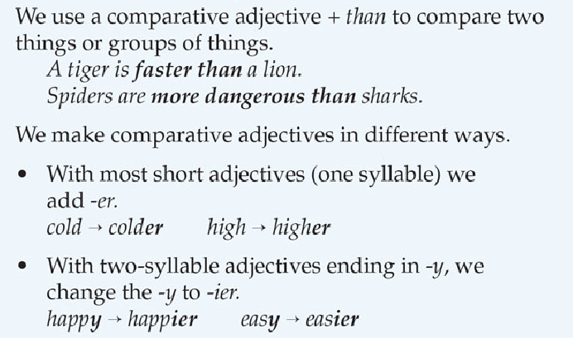
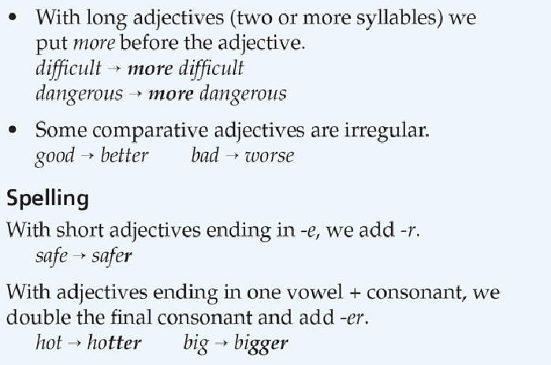
COMPARATIVE ADJECTIVES

Slide 7
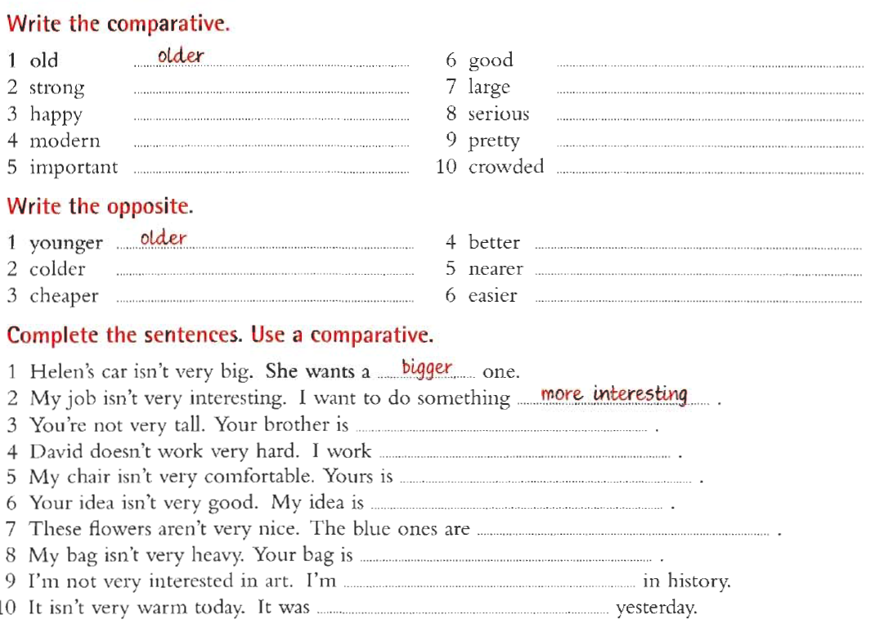
better
stronger
larger
happier
more serious
more modern
prettier
more important
more crowded
worse
hotter
further
more expensive
more difficult
taller
harder
more comfortable
better
nicer
heavier
more interested
warmer

Slide 8
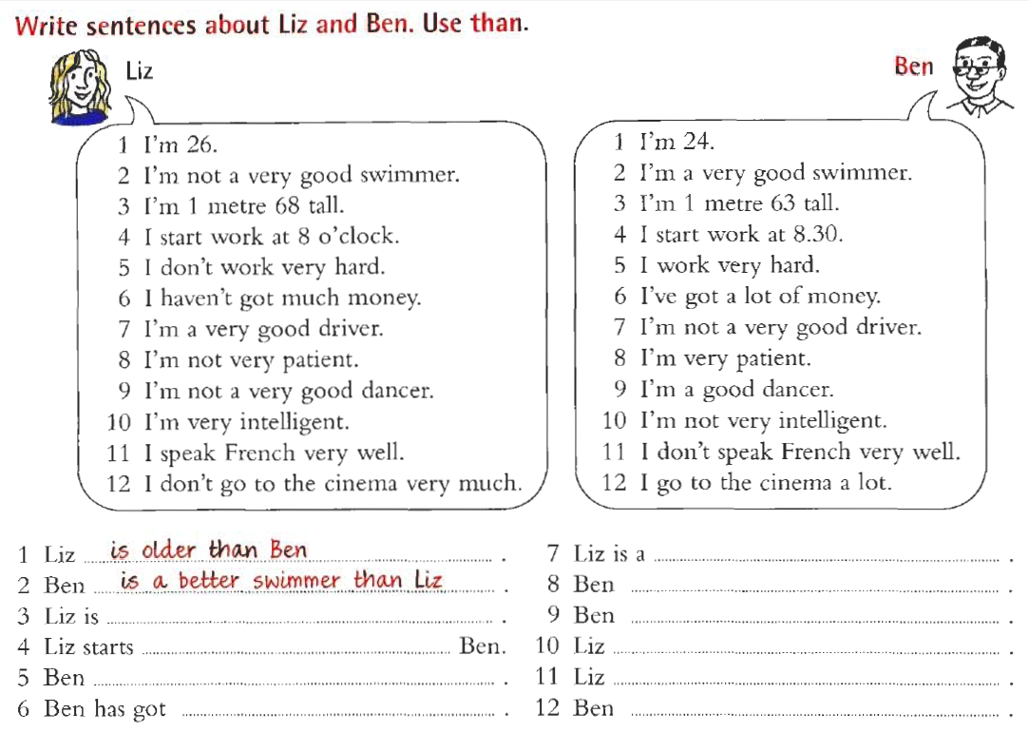
better driver than Ben
is more patient than Liz
taller than Ben
is a better dancer than Liz
work earlier than
is more intelligent than Ben
works harder than Liz
speaks French better than Ben
more money than Liz
goes to the cinema more (often) than Liz

